Slide 1
Madrid – Spain 13 December 2019

Slide 2
Building a Voice Assistant for PowerBI
David Alcalá Mota
Data & AI Consultant – Kabel
dalcala@kabel.es
Jesús Arnau Villar
Data & AI Cloud Architect – Kabel
jarnau@kabel.es

Slide 3
Building a Voice Assistant for PowerBI
Madrid – Spain
13 December 2019
David Alcalá Mota
Data & AI Consultant @ Kabel
Jesús Arnau Villar
Data & AI Cloud Architect @ Kabel

Slide 5
WHY???

Slide 6

Why Building an Analytics Assistant driven by Voice
It all started like this…..

Slide 7

Why Building an Analytics Assistant driven by Voice
Hey Guys!! I’ve just purchased a voice assistant speaker
What makes you so funny ???? Are you laughing at me ???
And what are you going to use it for? To play music? To tell you what the weather will be like?

Slide 8
Why Building an Analytics Assistant driven by Voice
Well ... I think that it can be used to view reports and have very quick access to information
What???
HOLD MY BEER!!!

Slide 9
Why Building an Analytics Assistant driven by Voice
How many of you have built a bot?
How many have thought about building a bot for automating tasks?
Is it effective for analytics?

Slide 10

Why Building an Analytics Assistant driven by Voice
At least, we found these benefits:
Simplify complex actions
Save user time -> increase the productivity
Provide users quicker & ubiquitous channels to access their info
Promote data driven culture in organization
Make user experience enjoyable (when it does work…)

Slide 11
All these questions led us to embark on a thrilling adventure ...

Slide 12


The Adventures of a
Voice Assistant
And the Riders of
The Power BI
Dataset

Slide 13


Ok Google, can you tell me the month-to-date sales in Spain?
Emmm…… if that info is available in a clean semantic model, published in PowerBI Premium where I can access, and with a Natural Language Processing layer deployed on top, maybe I could….
Notes:
> Entra gif contestacion de Google.
Empezamos a mirar como hacerlos, y vimos que con LUIS quizá podriamos...¿Cuantos habeis usado LUIS? ¿Cuantos lo conoceis al menos? Vale entonces explicaré algunos conceptos con más detalle...El caso:
GIF:
Conseguimos montar una demo pequeñita, que os la muestro:
Demo:
Open PowerBi Assistant? Oil&Gas assistant?

Slide 14
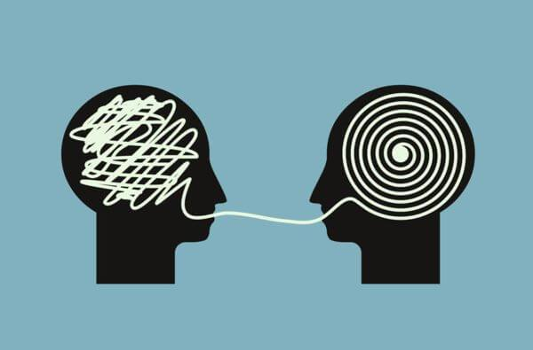
Natural Language Processing (NLP)
In PowerBI? QnA and its API
QnA lacks context
Reinvent the wheel? Or extend?
LUIS dependancy on QnA
Is it worth the try?
Notes:
Definition:
Natural Language Procesing
Analysis of text to extract meta-data from content such as concepts, keywords, categories, relations and sentiments. Extract information about people, places, events and much more, mentioned in text documents, news articles or blog posts

Slide 15
Ok Google, can you tell me the month to date sales in Spain?
Emmm…… if that info is available in a clean semantic model, published in PowerBI Premium where I can access, and with a Natural Language Processing layer deployed on top, maybe I could….
Notes:
> Entra gif contestacion de Google.
Empezamos a mirar como hacerlos, y vimos que con LUIS quizá podriamos...¿Cuantos habeis usado LUIS? ¿Cuantos lo conoceis al menos? Vale entonces explicaré algunos conceptos con más detalle...El caso:
GIF:
Conseguimos montar una demo pequeñita, que os la muestro:
Demo:
Open PowerBi Assistant? Oil&Gas assistant?

Slide 16
It’s Show Time!!!
Free Query Analysis

Slide 17


Demo – Free Query Analysis
Google Home
Web Output

Slide 18
How did we build all of these?
?

Slide 19

We had a long path ahead…

Slide 20

…and we found some challenges on the way

Slide 21

Challenge I
Adding a Voice Channel

Slide 22
Adding a Voice Channel
Which channels want our bot to work with?
Which are valuable for the final user?
How do we create each channel?
Is there code available for quick integration in our solution?
How do we integrate the channels?

Slide 23
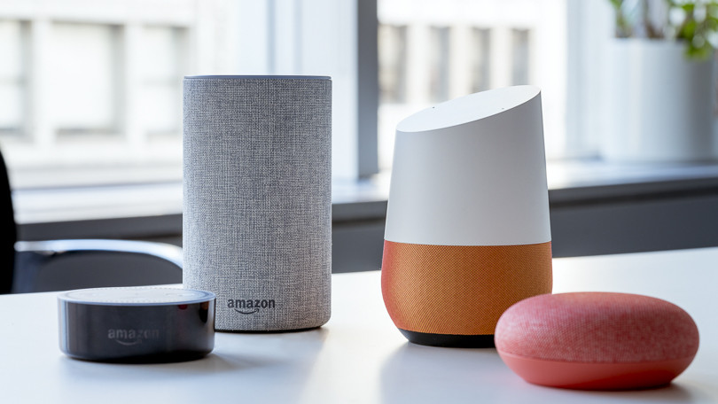
How to make your bot Multichannel…?

Slide 24

…Without forgetting strategic ones

Slide 25
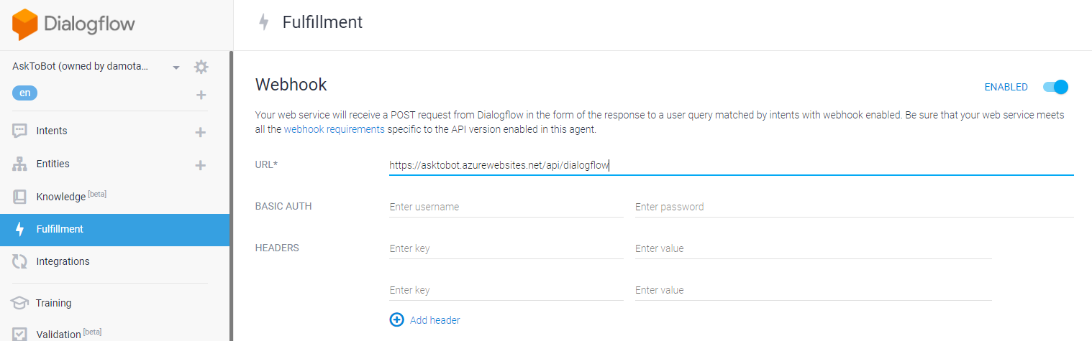
Adding a Voice Channel – Google Assistant
Create a Google Assistant Project, and set its webhook url to our Bot framework application

Slide 26
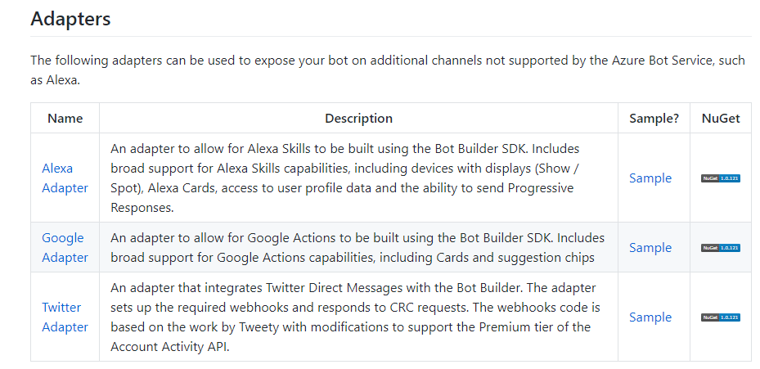
Adding a Voice Channel – Bot Framework Adapters
https://github.com/BotBuilderCommunity/botbuilder-community-dotnet#adapters

Slide 27
Adding a Voice Channel – Teams Integration
Creating a Bot from Scratch, adds an out of the box channel that can be used for Teams Integration, and for the rest of the channels that ship default with the Bot Framework
Return content using simple text, Attachment and Card Actions to display rich content, such as images and buttons.
Defined in default Bot.Schema

Slide 28
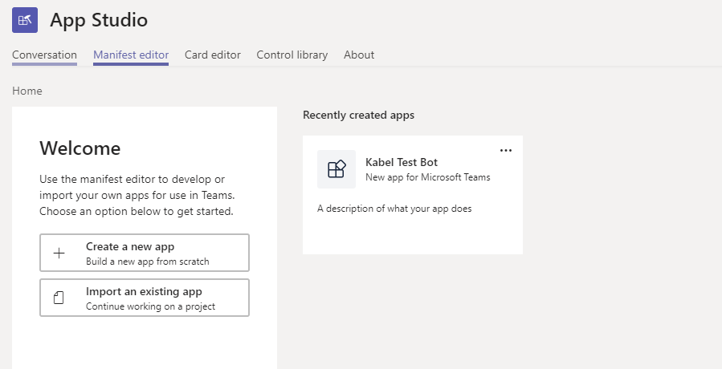
Adding a Voice Channel – Teams Integration
Use App Studio

Slide 29
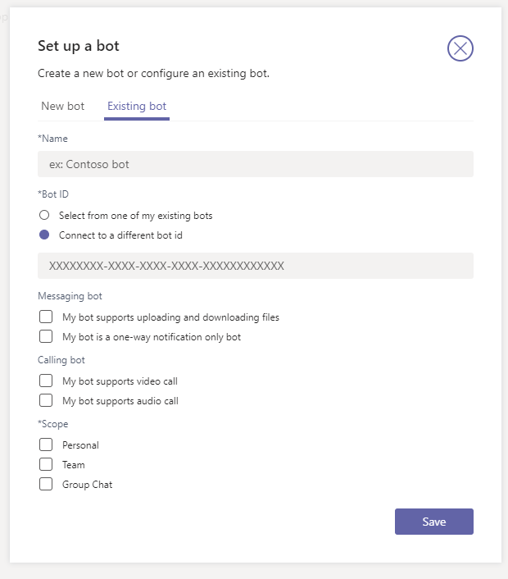
Adding a Voice Channel – Teams Integration

Slide 30
Challenge II
Displaying Results

Slide 31
Displaying Results
How and where do we plot the visuals?
Do we need an additional display?
Do we bring a screenshot and attach it? How?

Slide 32

Displaying Results – Plotting Visuals – Power BI
Render visuals using Power Bi Embedded
Use Role Based Access Control. Power BI now supports Service Principal Authentication
Using Qna Embedded to generate visuals on demand. Focus on Dataset

Slide 33

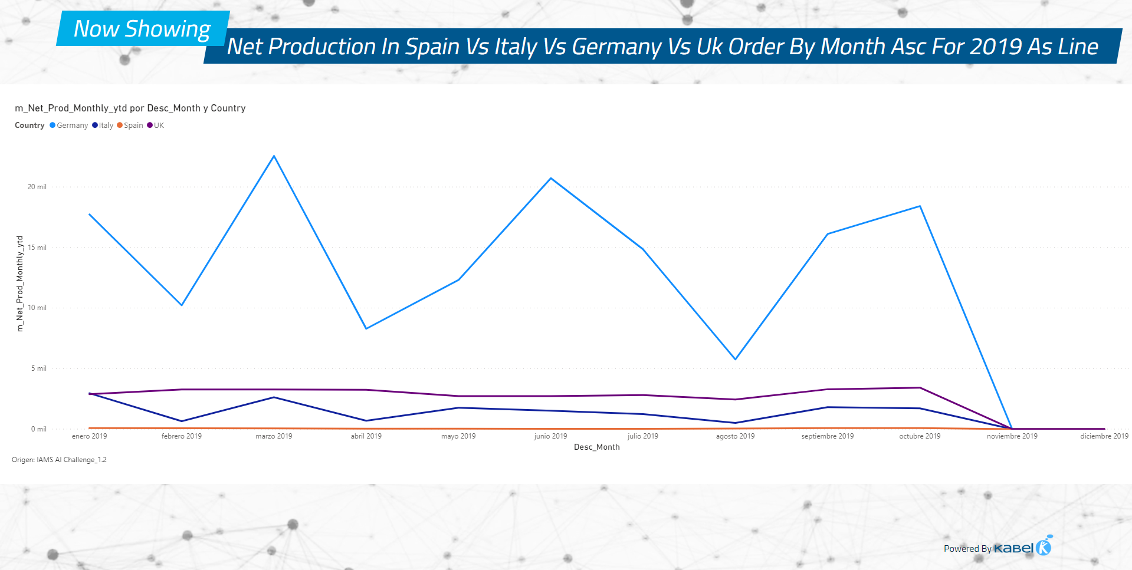

Slide 34
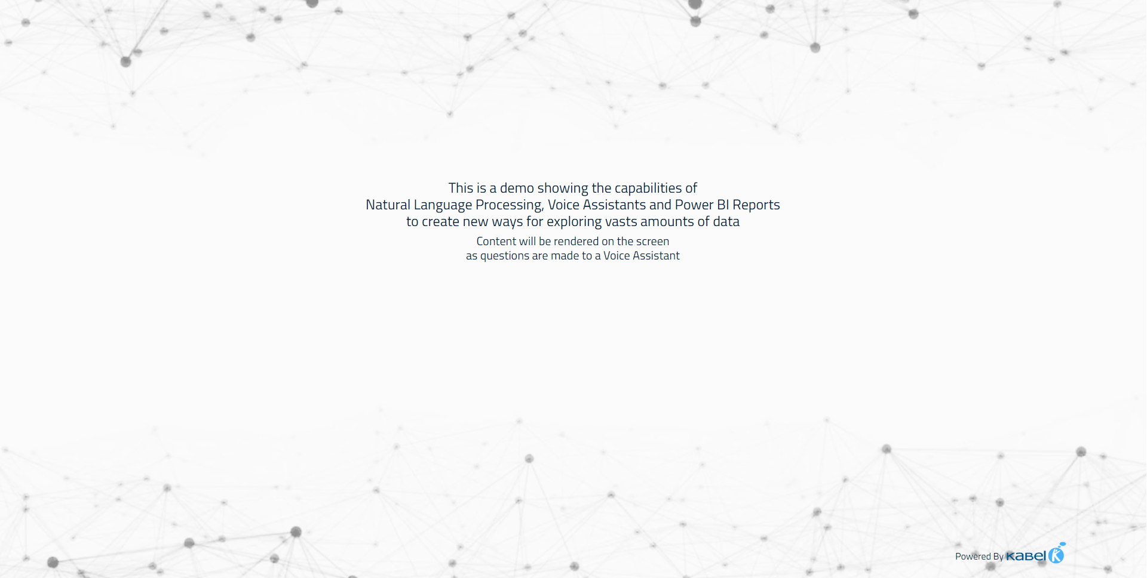
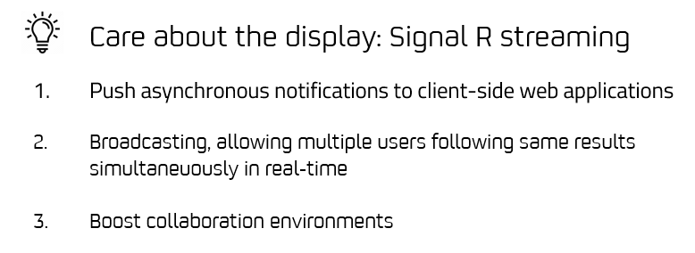

Slide 35



Displaying Results – Static Images
Need to enclose live updates and “apify” it to generate static images to return to the user
Use a headless browser and render its content.
Take in-memory snapshot and return it as a content-type image/png, as soon as the image is rendered

Slide 36
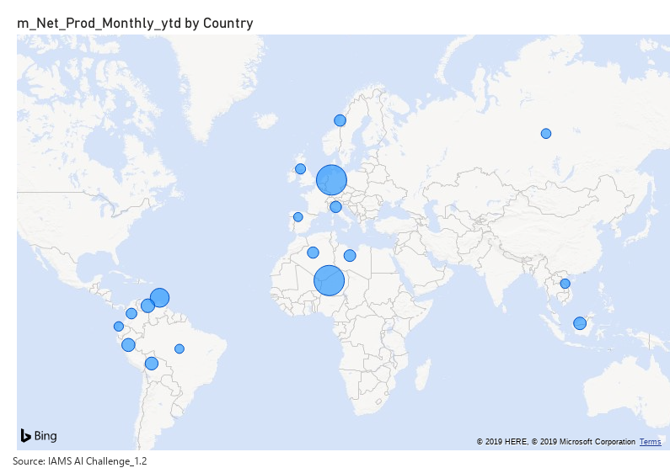
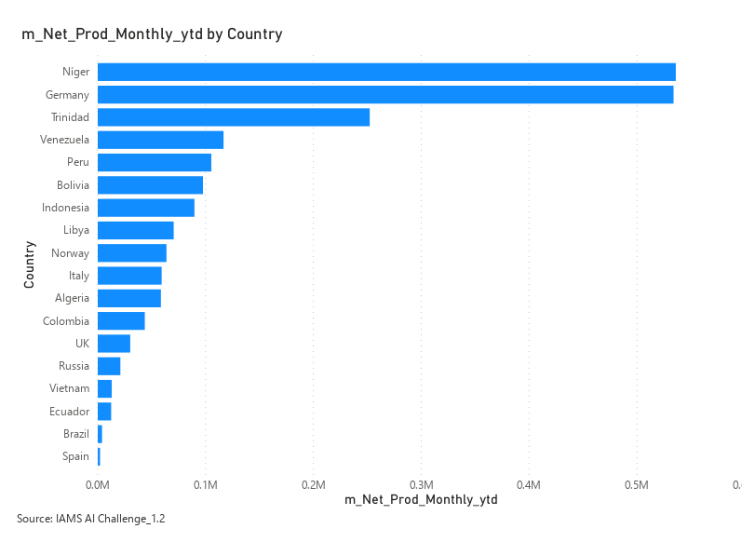
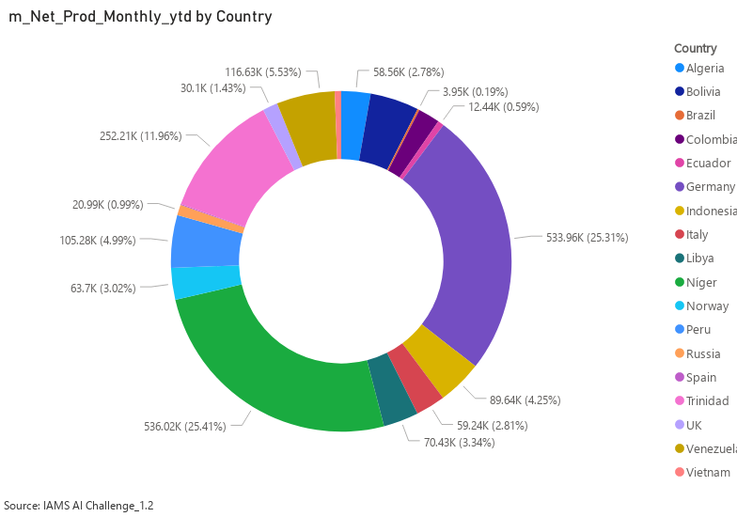
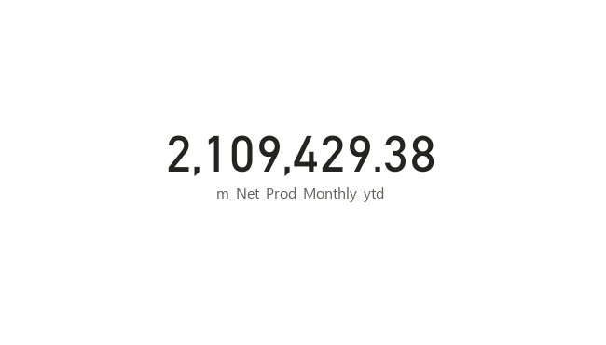
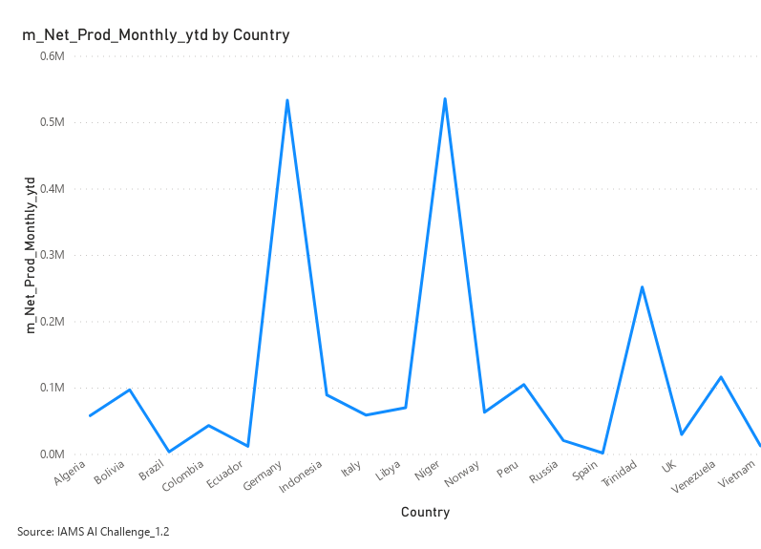
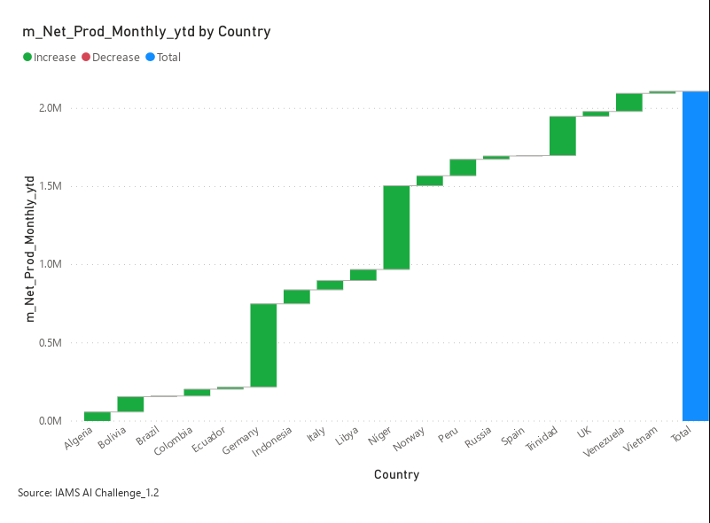
Displaying Results – Static Images

Slide 37
Challenge III
Applying
Intelligence

Slide 38
Applying Intelligence
How can we extract measures, filters and visualization modes, from user speech?
How to bring just the measure result text when the question returns a single value?
Can we translate user requests to have also Spanish enabled dialog?

Slide 39
Applying Intelligence – Cognitive Services
Use Computer Vision API to extract text from a visual Card Type
Show me production
Net Production is 2.11 million

Slide 40
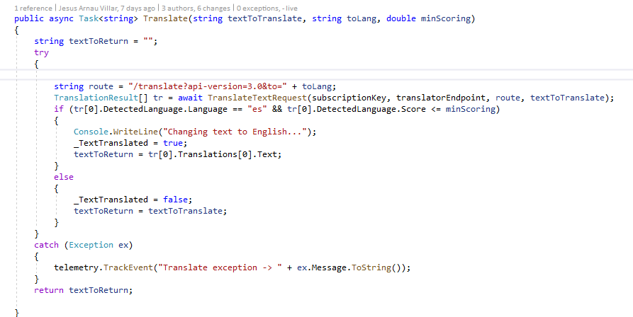
Applying Intelligence – Cognitive Services
Use Text Translation

Slide 41
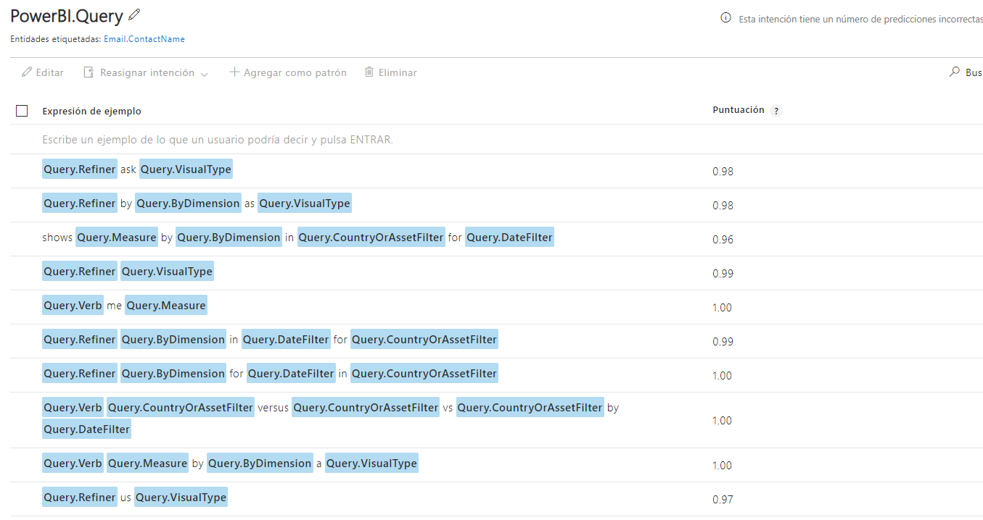
Applying Intelligence – Cognitive Services
Bringing NLU With LUIS – Intents

Slide 42
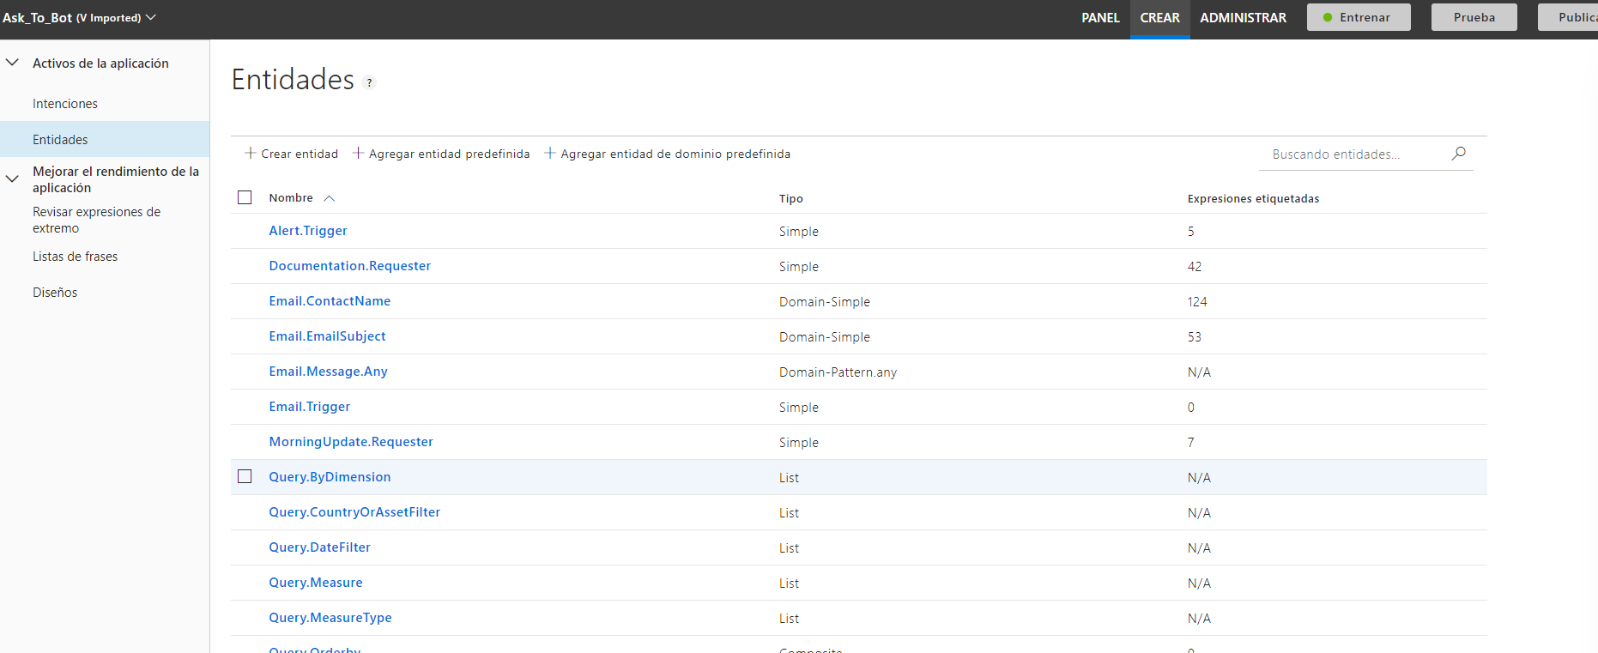
Applying Intelligence – Cognitive Services
Bringing NLU With LUIS - Entities

Slide 43
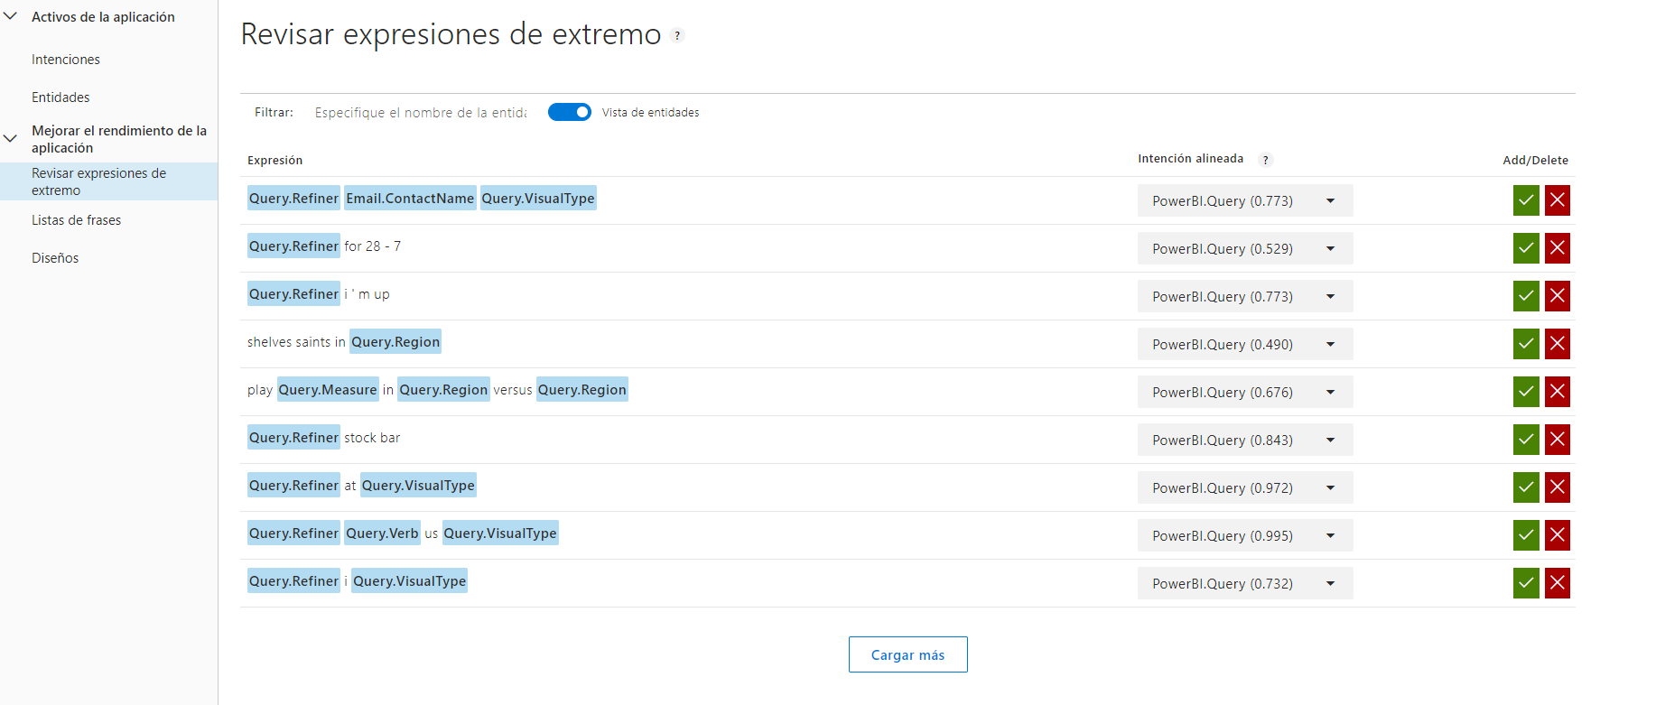
Applying Intelligence – Cognitive Services
Bringing NLU With LUIS – Retrain for new utterances

Slide 44
Challenge IV
Using PowerBI
Datasets

Slide 45

Power BI Model

Slide 46

Power BI Model

Slide 47
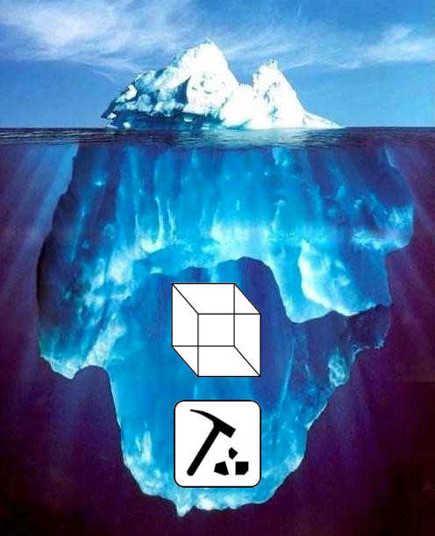
Power BI Model

Slide 48
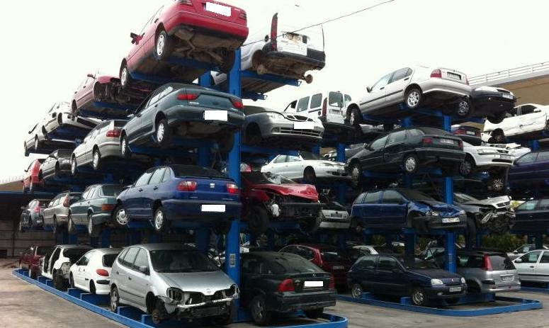
Power BI Model
Our Wish, Our Dream

Slide 49
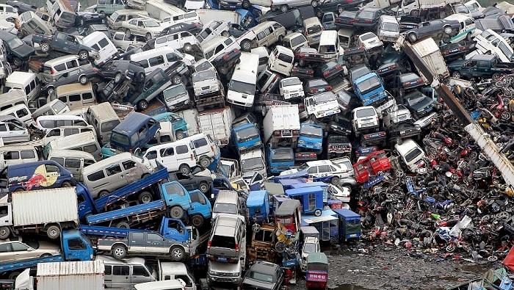
Power BI Model
Harsh Reality

Slide 50
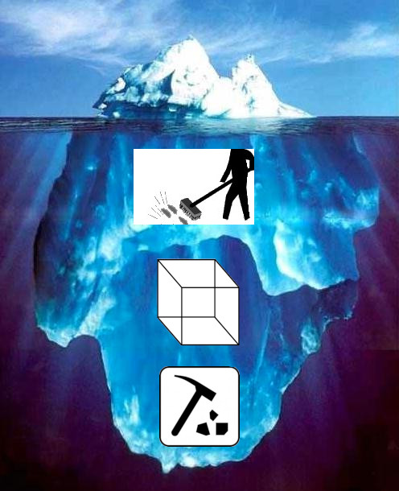
Power BI Model

Slide 51
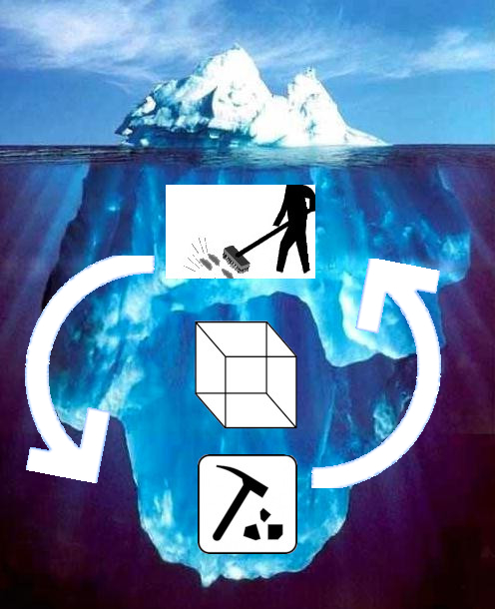
Power BI Model

Slide 52
Power BI Model

Slide 53
Refining Requests
Requests
Requests with Refining

Slide 54
Refining Requests
Requests
Own Entity
It contains all the information
Direct Resolution
Example: “Show me production by country as map

Slide 55
Refining Requests
Requests with Refining
Needs more information
It is based on a previous request
Needs transformations
Example: “Show as Line”

Slide 56

Refining Requests
How does our bot identify them?

Slide 57

Refining Requests
Now
Request with defining
Change
Filter
KeyWords
…

Slide 58
Example Refining Queries
Show me production
by country as map

Slide 59

Example Refining Queries
Verb: Show
LUIS
Measure: Production
Group: Country
Visual: Map
Show me production
by country as map

Slide 60
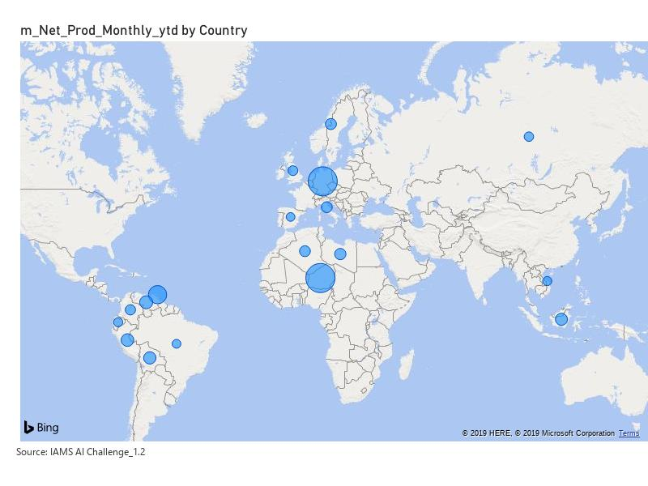
Example Refining Queries
Verb: Show
LUIS
Measure: Production
Group: Country
Visual: Map
Show me production
by country as map

Slide 61
Example Refining Queries
Now as Line
for 2019

Slide 62
Example Refining Queries
Key Word: Now
LUIS
Visual: Line
Year: 2019
Now as Line
for 2019

Slide 63

Example Refining Queries
Key Word: Now
LUIS
Visual: Line
Year: 2019
Now as Line
for 2019

Slide 64
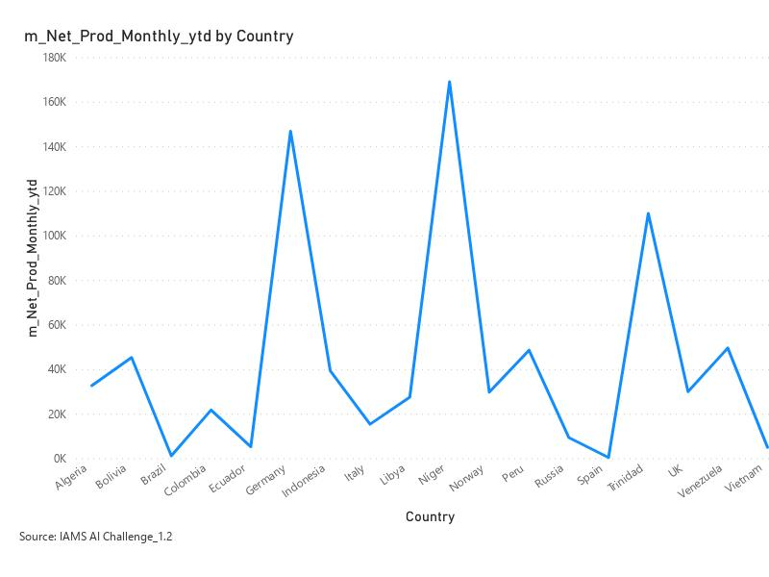
Example Refining Queries
Entity | Query Saved | New Request
Verb | Show | ---
Measure | Production | ---
Group | Country | ---
Visual | Map | Line
Year | --- | 2019
Show Production By Country
as Line 2019

Slide 65
It’s Show Time!!! Part 2
Teams Demo – Video Recording

Slide 66
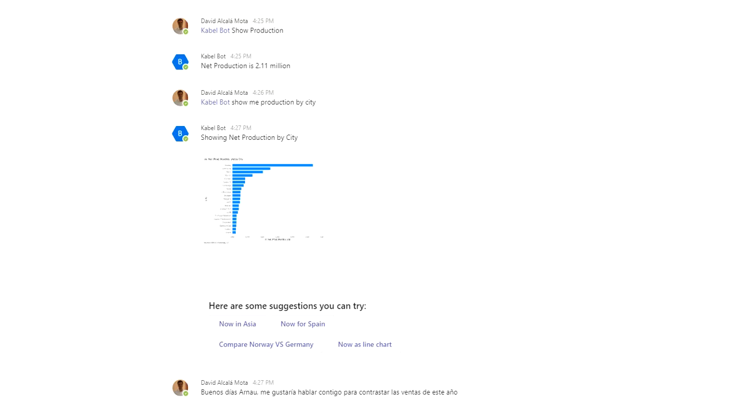

Slide 67
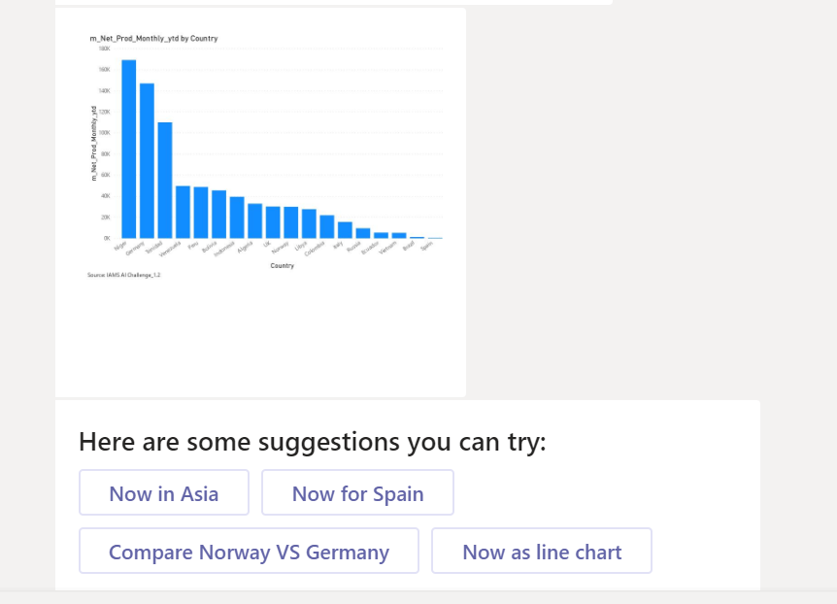
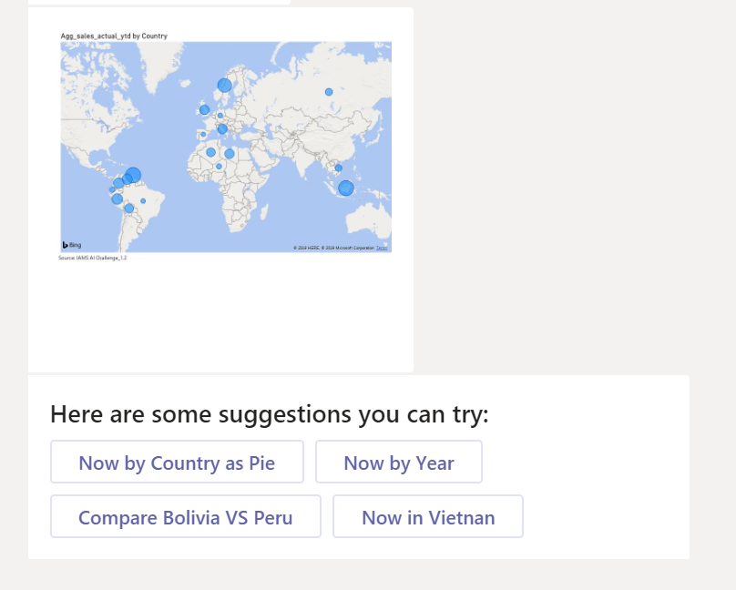
Suggestion Chips

Slide 68
Architecture Diagram

Slide 69
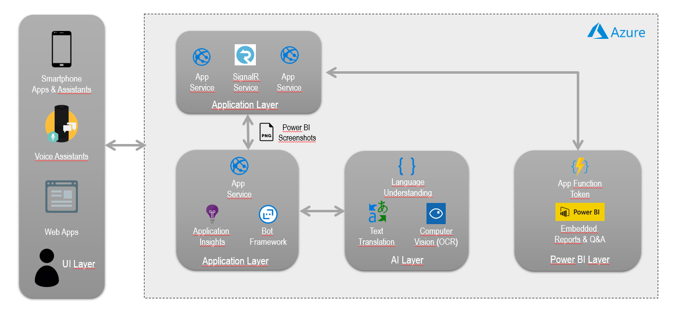
Architecture Diagram

Slide 70
Next Steps
Where do we go from here

Slide 71
Next Steps
Integrate Alexa
Pure queries instead of OCR -> Dax Queries -> Get concrete Values
Consume any analytics model. Get rid of Power BI
Standardize Methodology
Incentivize Promotion of Datasets adding them automatically to the bot
Key: Model standards compliance and business query process definition
Data OPS

Slide 72
Next Steps. Auto Feed – Ingestion
XMLA Endpoints + LUIS API!
Query Structure: Populate new entities, if new dimensions appear
Query Values: Update existing entities by populating the latest information in the model

Slide 73
Next Steps. Auto Feed – Populating LUIS
API for programmatically populating your LUIS!
Add entities
Add intents
Add utterances
Train Model
Publish Model
https://github.com/microsoft/NLU.DevOps

Slide 74
Next Steps. Machine Learning
Forecasting: Show me the time to fail for Engine number 4
Anomaly Detection: Show me if there are any strange patterns on the Engine number 4
Suggestion Chips Recommendations to be smarter, more context adaptive

Slide 75
Acknowledgements
This was a team effort

Slide 76
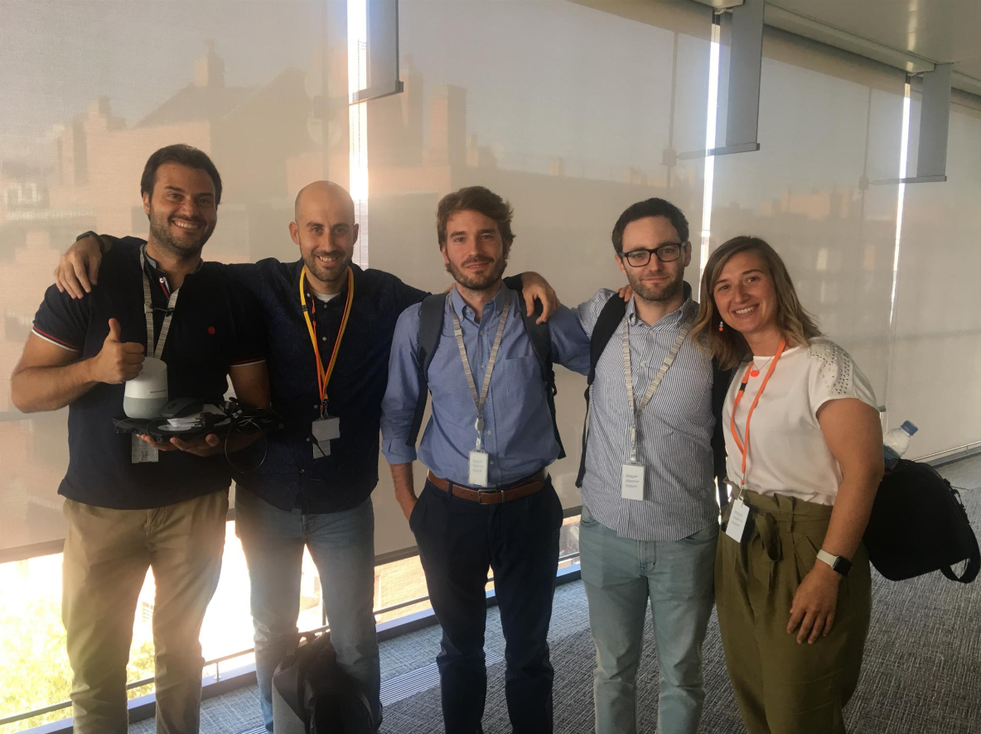
Acknowledgments – Team Success
This wouldn’t been possible without:
Fran Mercado
Jose Carlos Muñoz
Irene Serrano

Slide 77
Acknowledgments – Team Success
And there is always that Shy Guy
Carlos Sacristán

Slide 78
Doubts & questions

Slide 79
Building a Voice Assistant for PowerBI
David Alcalá Mota
Data & AI Consultant – Kabel
dalcala@kabel.es
Jesús Arnau Villar
Data & AI Cloud Architect - Kabel
jarnau@kabel.es

